Slide 1




Properties of the Gaia- DR1
Après Hipparcos : Gaia
F. Mignard
UCA/CNRS/ Observatoire de la Côte d'Azur
Notes:
1

Slide 2
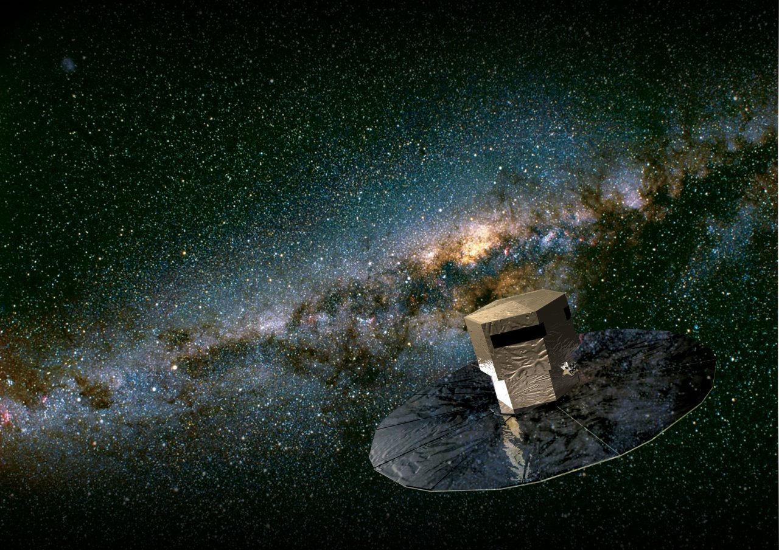
The Gaia Mission
Mission of ESA selected in 2000
Launched on 19 December 2013
Goal : Study of the history, composition of the Milky Way
  Observation of a 1 billion stars to magnitude 20
  Distance measurement from parallaxes ➔ 0" 000 01
  Radial velocities, spectrophotometry
10 µas ~ 1 coin on the Moon!

Slide 3

3

Slide 4
Relevant numbers for Gaia & the DR1
The DR1
  Appears 1000 days after launch
  Covers data acquired from 25 July 14 to 15 Sept 15
  30 billion transits detected
    300 billion astrometric elementary observations
    3 billion sources matched
4

Slide 5
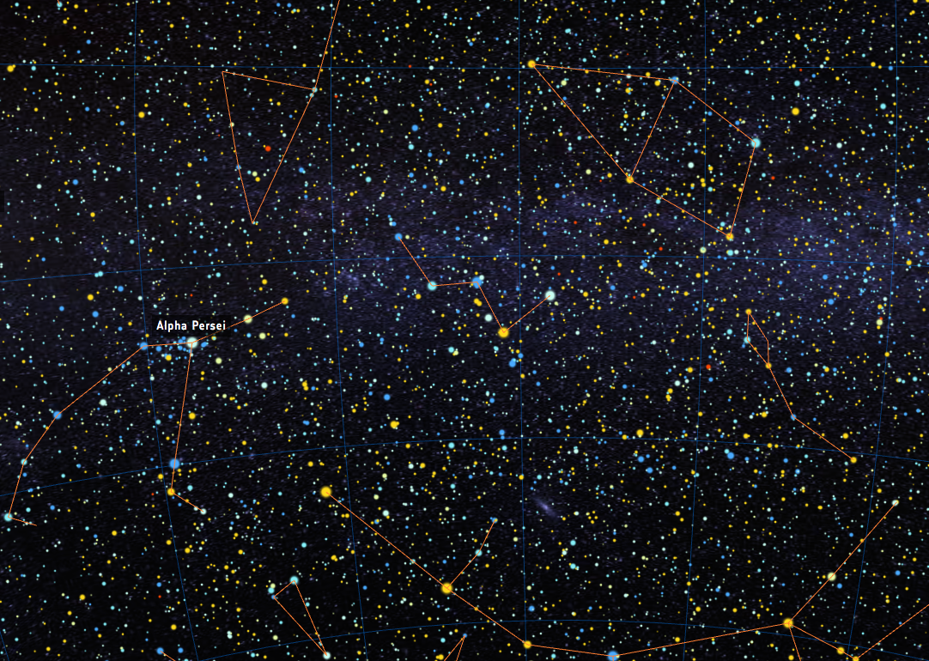
A billion star catalogue
the largest ever
5

Slide 6
A 2-million star catalogue
with
parallaxes and proper motions
the most accurate ever
6

Slide 7
2200 Reference Frame Quasars
the best frame ever in optics
7

Slide 8
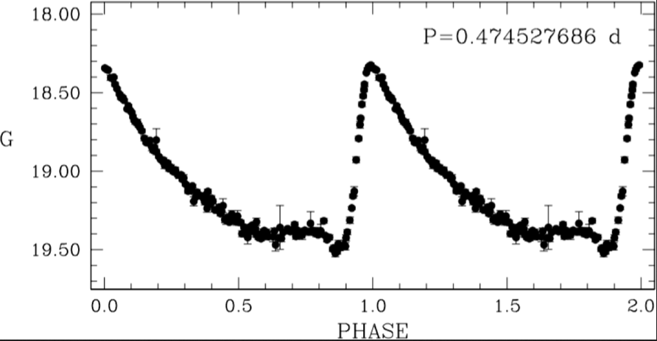
3500 variable stars
with
light-curves and periods
8

Slide 9
The Sky Census
A billion stars
9

Slide 10
The Star Catalogue
A position catalogue for 1.14 billion stars
  full sky coverage
  Positional accuracy from 0.5 mas to 15 mas
  Aligned to ICRF to 0.1 mas – 0.03 mas/yr
  450 million new sources
Integrated magnitude for every source
credit : ESA/Gaia/DPAC
10

Slide 11
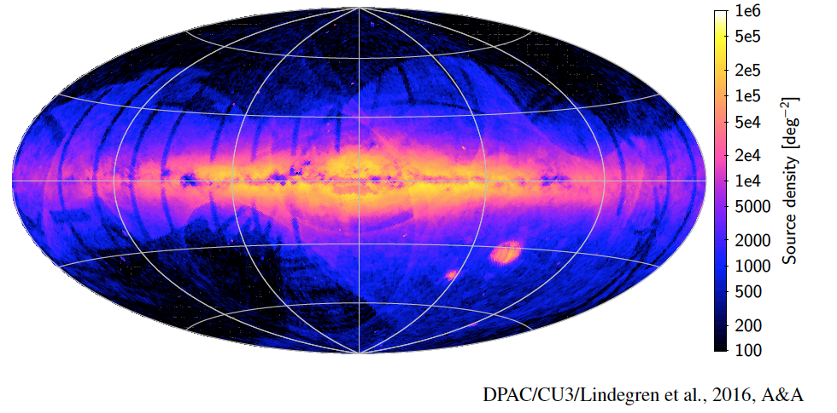
The Star Catalogue
A position catalogue for 1.14 billion stars
  460 million new sources
credit : ESA/Gaia/DPAC
11

Slide 12
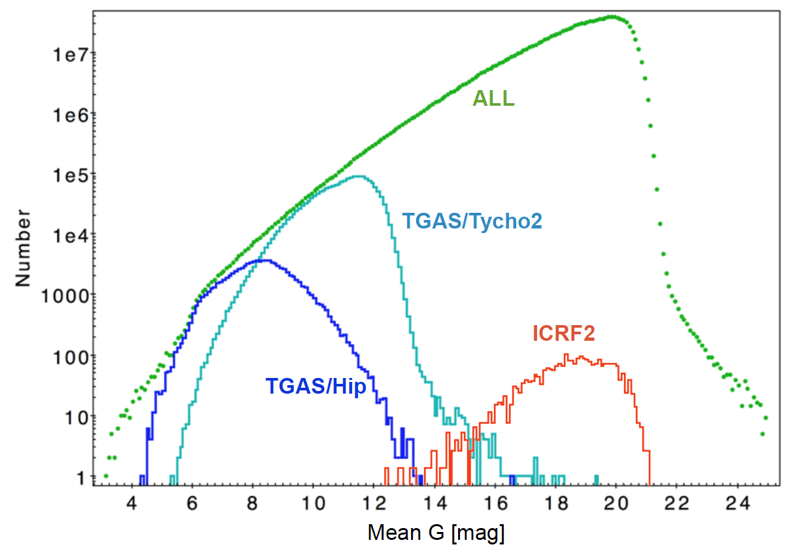
The Star Catalogue
Magnitude distribution of the Gaia DR1
credit : ESA/Gaia/DPAC
12

Slide 13
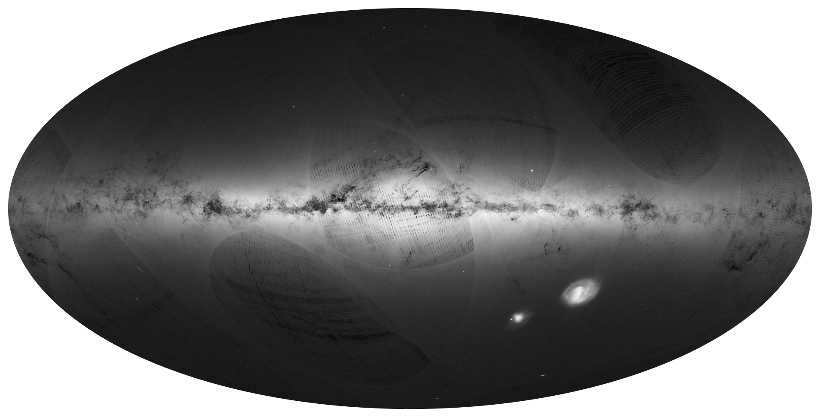
Credit: ESA/Gaia/DPAC
Image generated by: André Moitinho & Márcia Barros (CENTRA - University of Lisbon) on behalf of DPAC

Slide 14
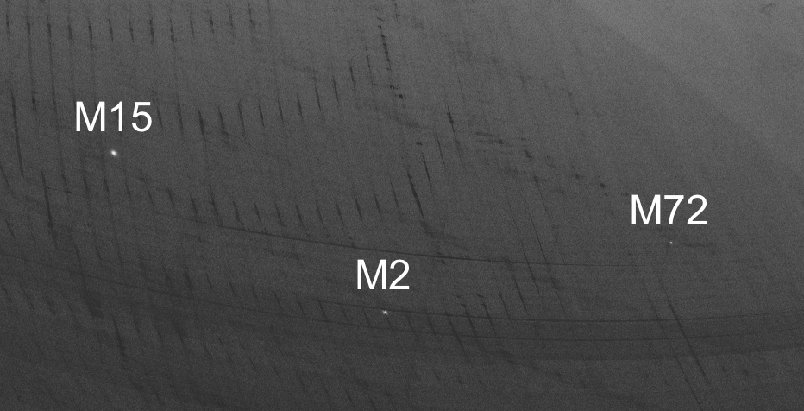
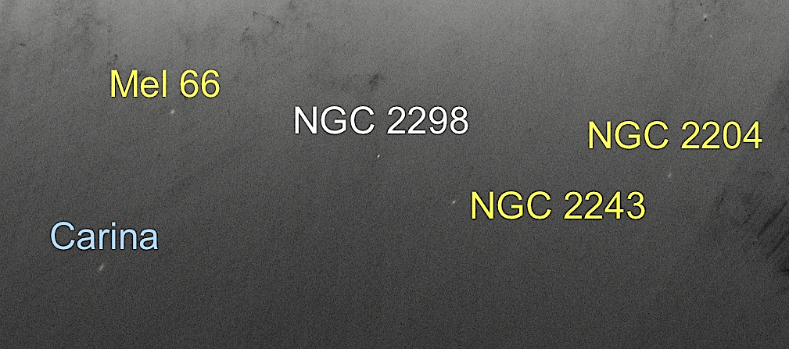
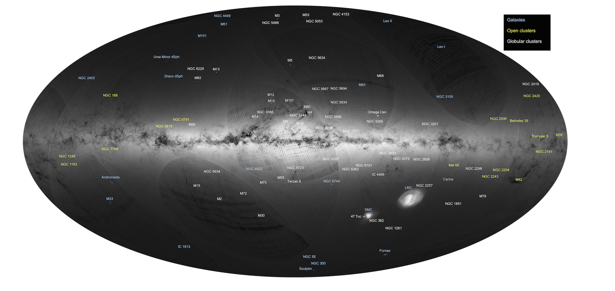
Credit: ESA/Gaia/DPAC
Image generated by A. Moitinho & M. Barros (CENTRA - University of Lisbon) and labelled by F. Mignard (OCA-CNRS) on behalf of DPAC

Slide 15
A 2-million star catalogue
with
parallaxes and proper motions
the most accurate ever
15

Slide 16
Content of the Gaia Data Release I (Gaia DR1)
Combined solution between Gaia and Hipparcos/Tycho(TGAS)
  2.06 million sources, mainly G < 11.5
  positions, distances, proper motion
  no bright stars ( G <6), no high PM stars (μ < 3.5 "/yr)
Median position uncertainty : 0.23 mas (in 2015.0)
Parallax accuracy ~ 0.3 – 0.6 mas - median = 0.32 mas
Proper motion accuracy ➔
Hipparcos ~ 0.07 mas/yr
Tycho ~ 1.2 mas/yr
16

Slide 17
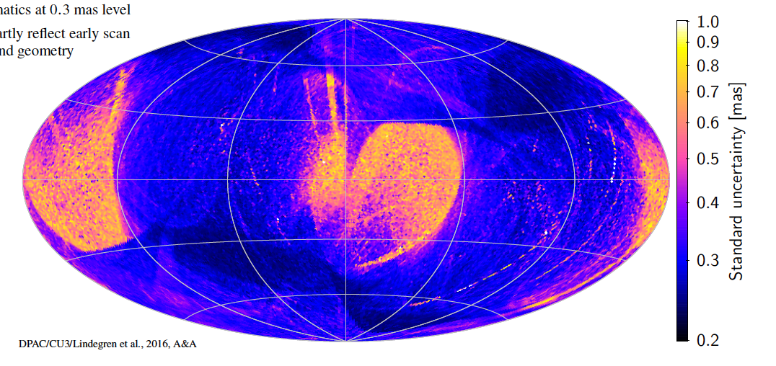
TGAS Parallaxes
Accuracy of Parallaxes
  2 to 3 times better than Hipparcos
  x20 for the number of stars
credit : ESA/Gaia/DPAC
17

Slide 18
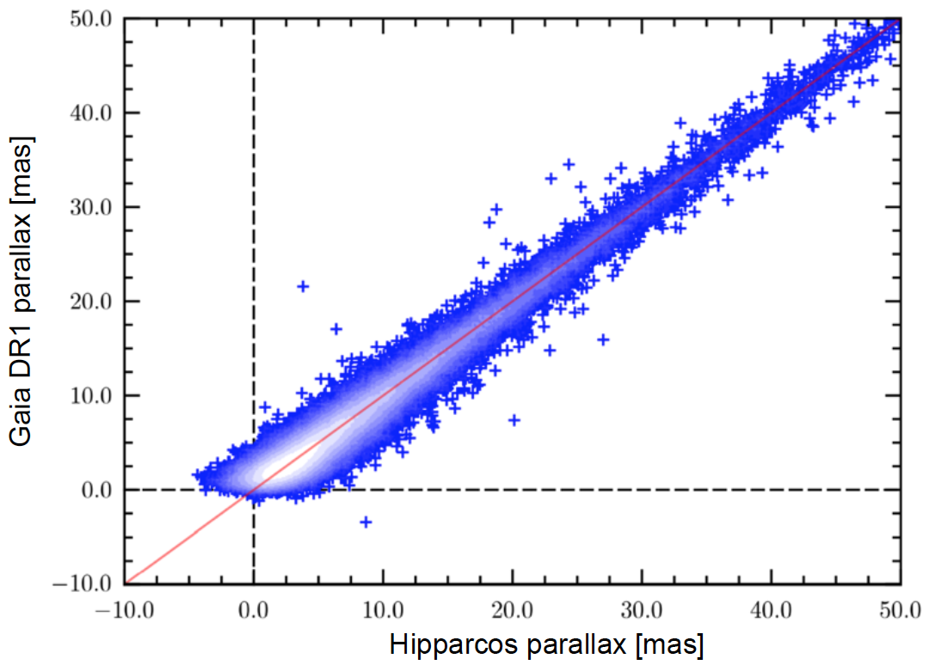
Quality of TGAS parallaxes
TGAS and Hipparcos parallaxes independent
Realistic errors published
Global zero point offset ~ -0.04 mas, local systematic ~0.3 mas
credit : ESA/Gaia/DPAC
18

Slide 19
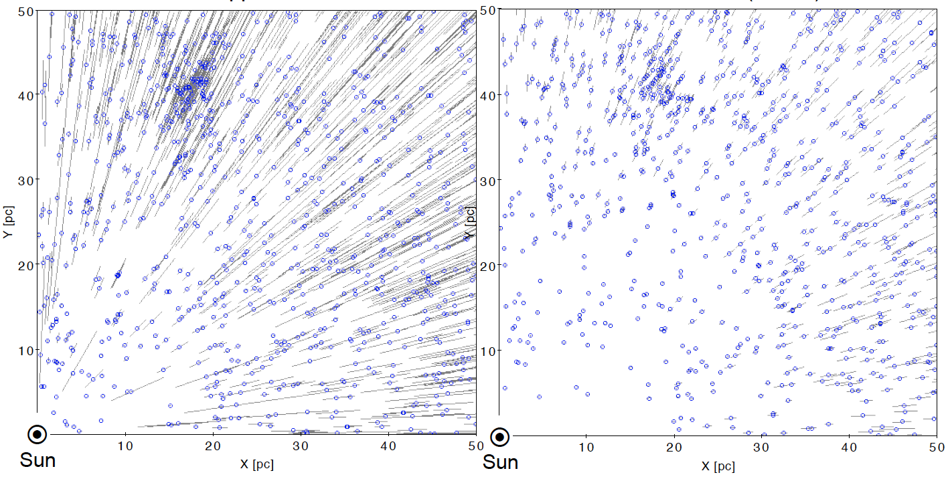
Visual improvement in distances
Hipparcos
TGAS
credit L. Lindegren
19

Slide 20
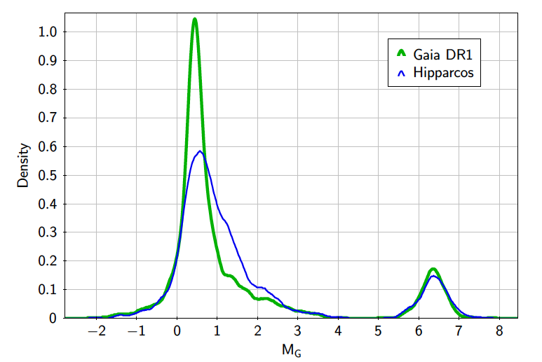
Red Clump with TGAS
Distribution of M_{G} for stars with :
credit : Brown et al., 2016
20

Slide 21
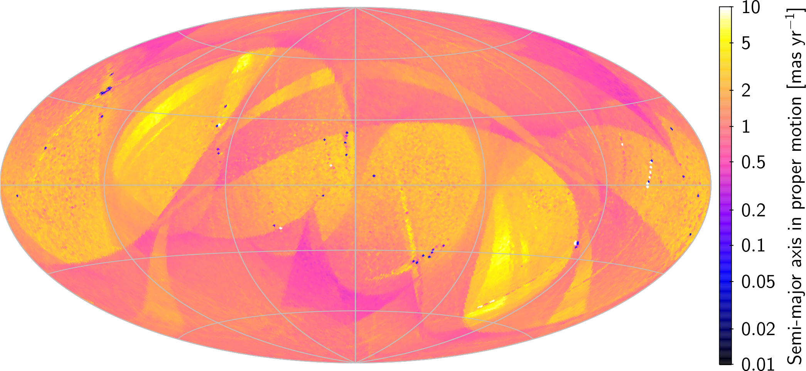
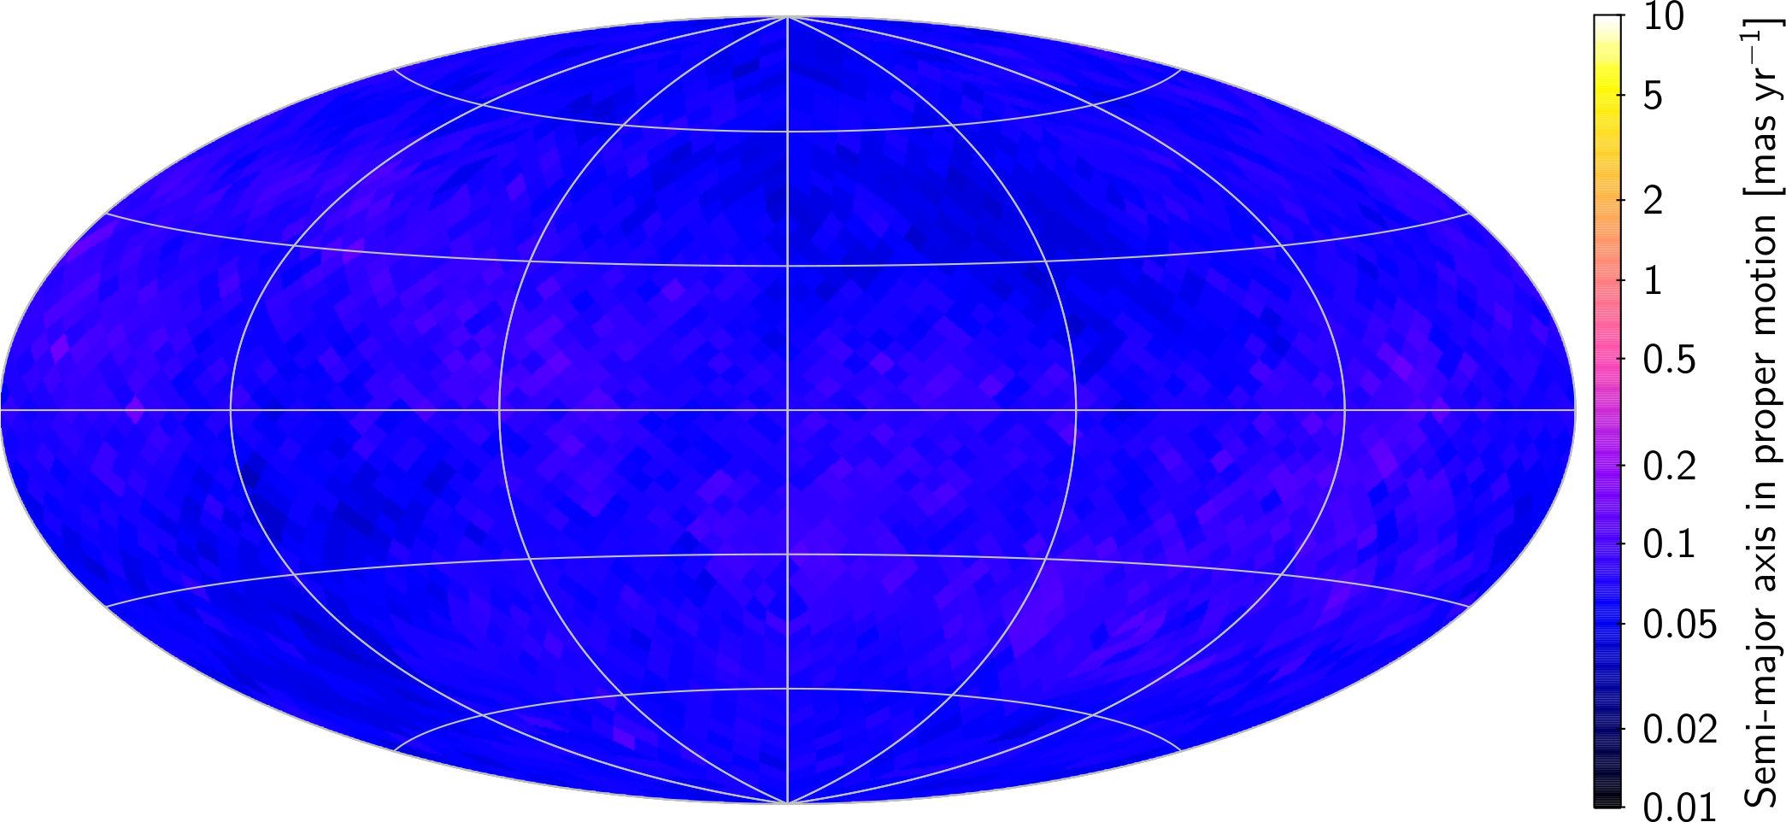
TGAS Proper Motions
Combined solution between Gaia and Hipparcos/Tycho(TGAS)
Tycho ~ 1 mas/yr
2 million stars
Hipparcos ~ 0.05 mas/yr
100,000 stars
credit : ESA/Gaia/DPAC
21

Slide 22
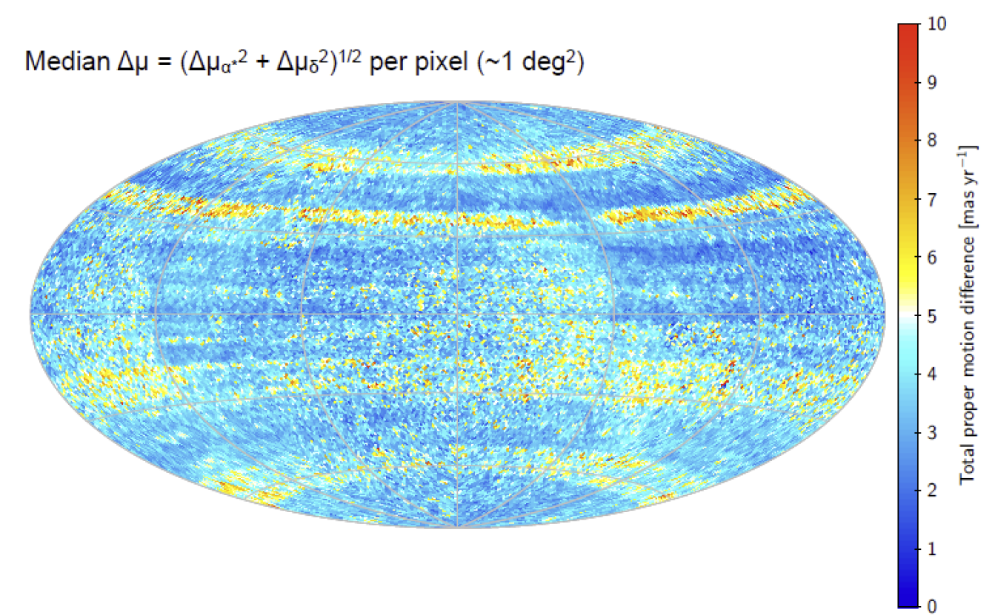
TGAS Proper Motions
Difference Tycho – TGAS
  large zone systematic errors
  linked to the Carte du Ciel
credit : Lindegren et al. , 2016
22

Slide 23
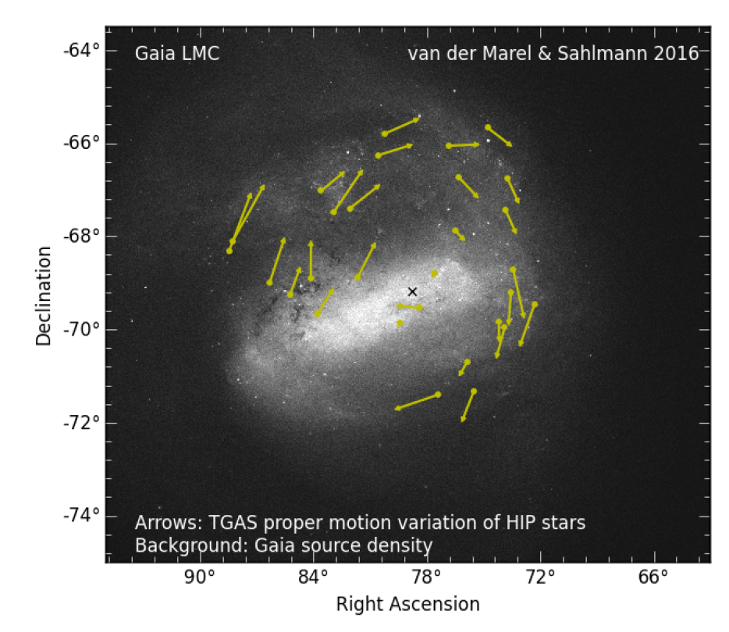
Application
23

Slide 24
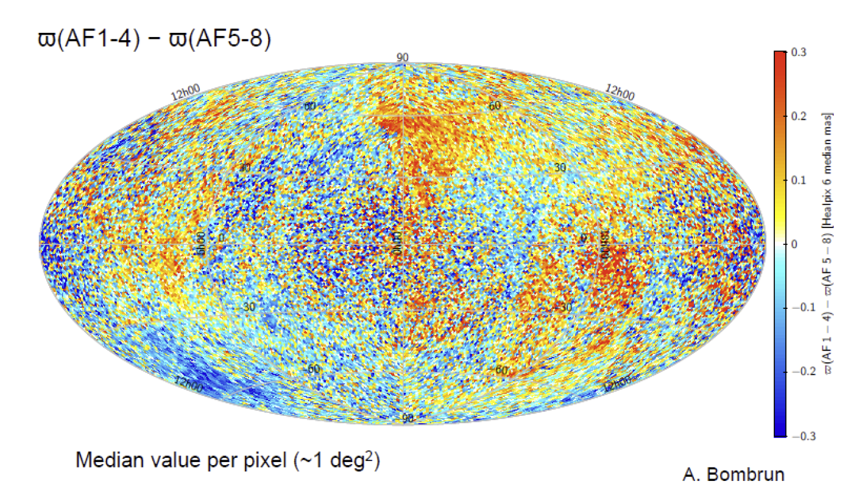
Validation TGAS parallaxes
Two solutions with independent data ('Split FOV solutions')
24

Slide 25
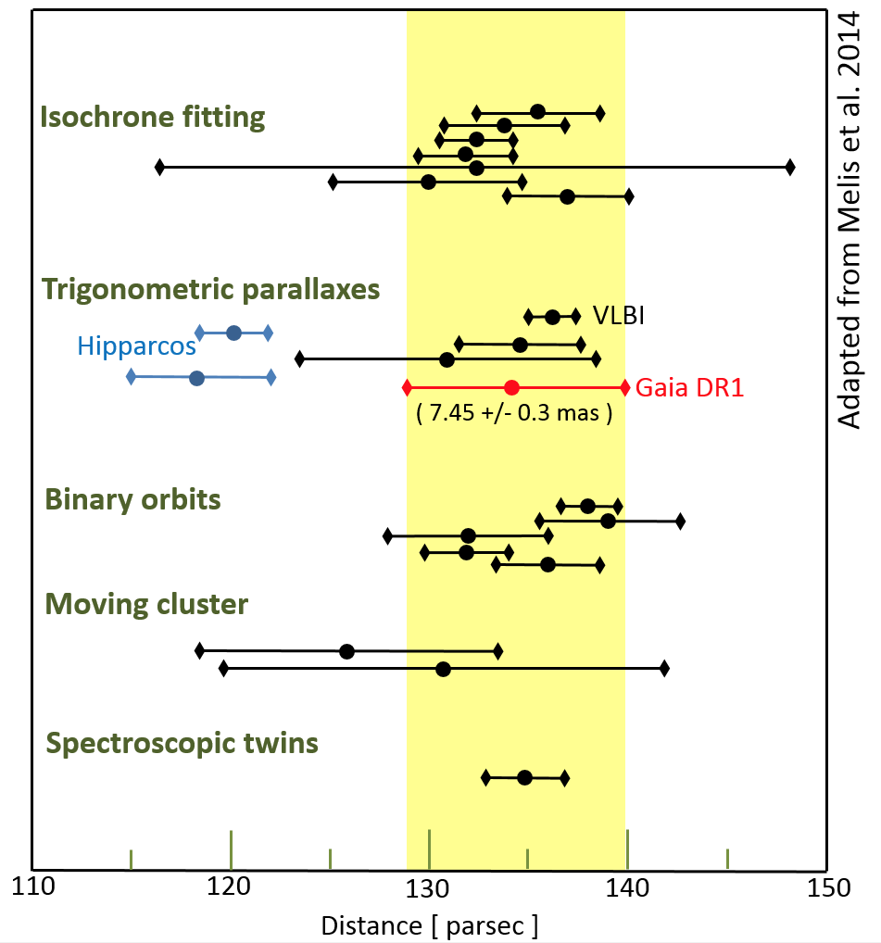
The Pleiades debate: a hot topic
The cluster distance has been reanalysed
  no final conclusion yet but …
This is the only cluster with a significant difference with Hipparcos
credit : ESA/Gaia/DPAC
25

Slide 26
2200 Reference Frame Quasars
the best frame ever in optics
26

Slide 27
Reference Frame
Solution of position for 2200 ICRF sources
  accuracy floor of 0.2 mas
  optical magnitude for the first time for most of them
  Global agreement with Radio positions to < 1 mas
  Hipparcos frame with rotation of 0.24 mas/yr
credit : ESA/Gaia/DPAC
27

Slide 28
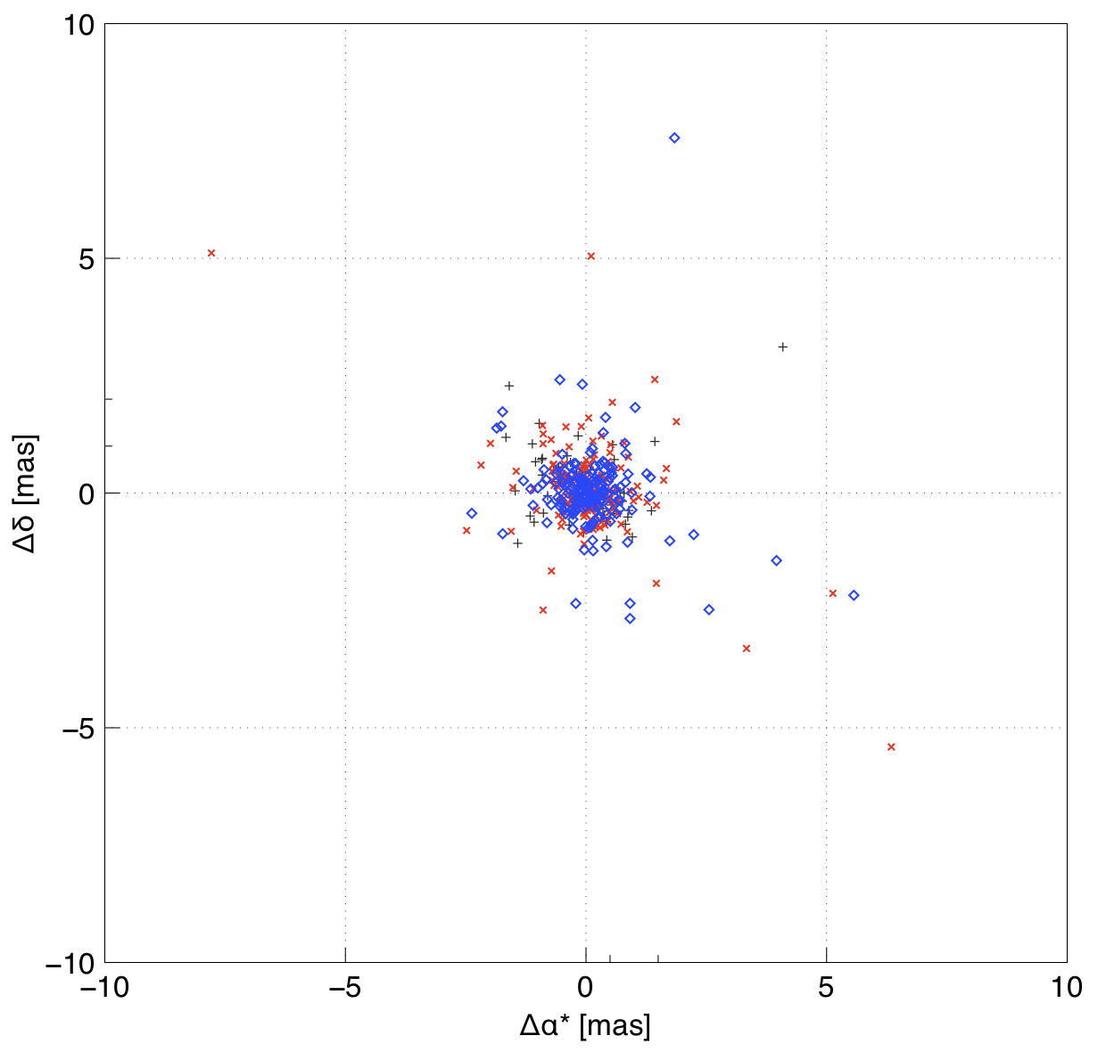
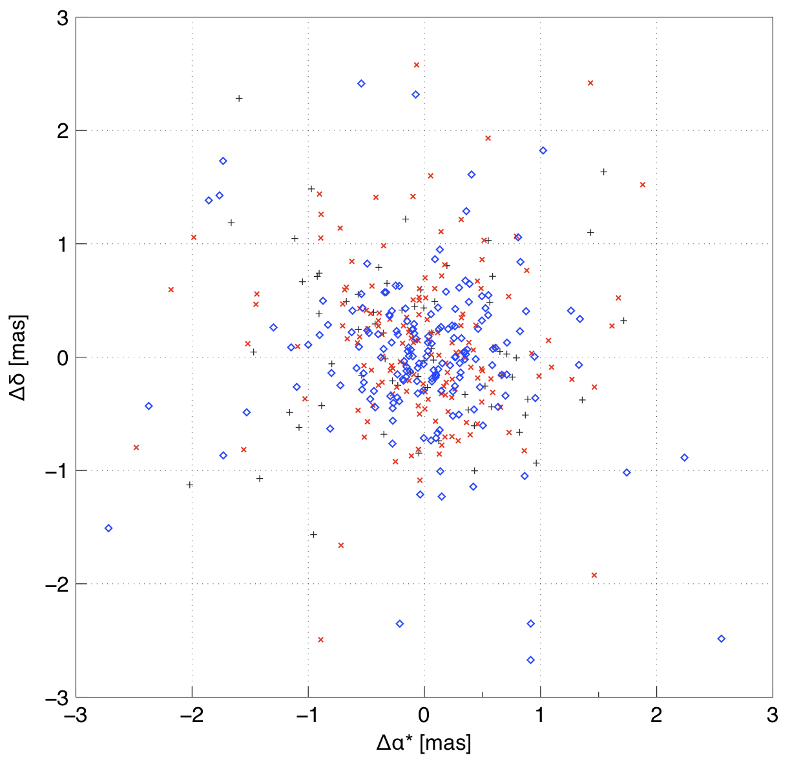
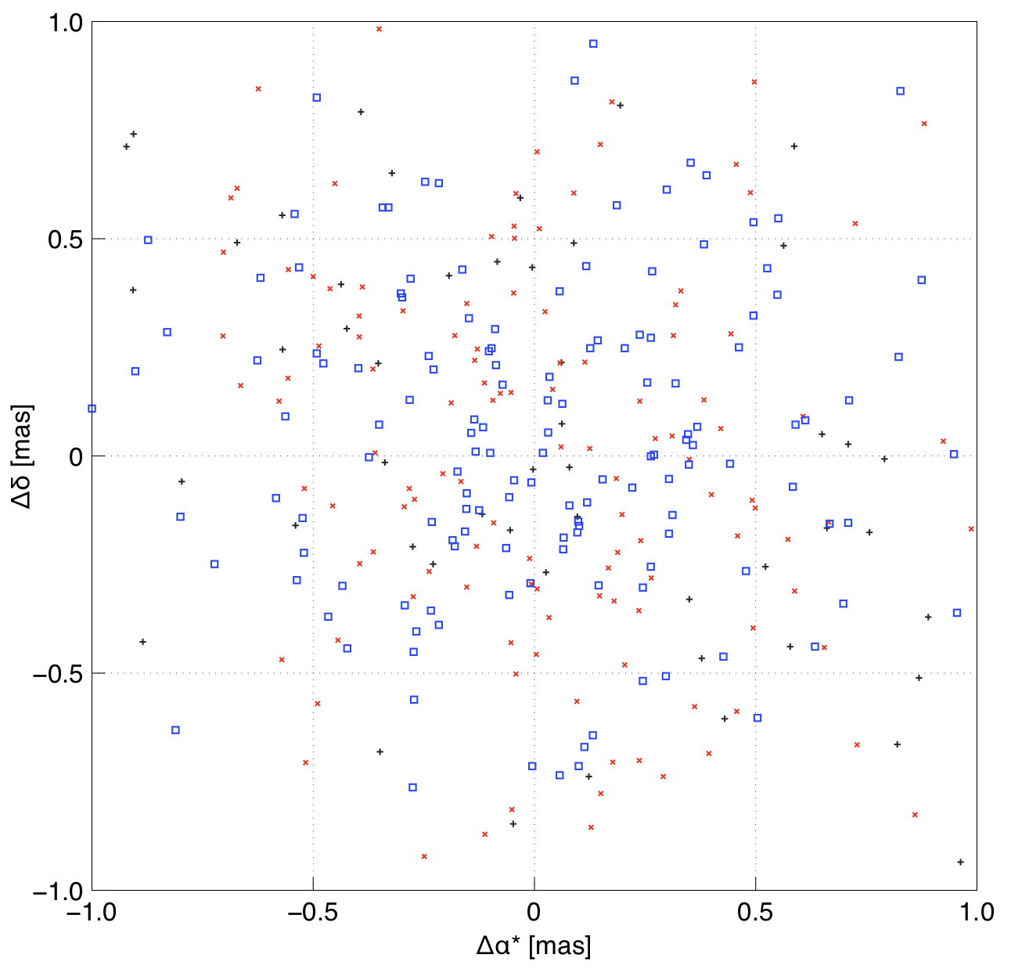
Reference Frame
Comparison to radio (VLBI) positions of ICRF2
defining
X
non-VCS
+
VCS
σ _{Gaia} < 3 mas
F. Mignard, S. Klioner
28

Slide 29
3500 variable stars
with
light-curves and periods
29

Slide 30
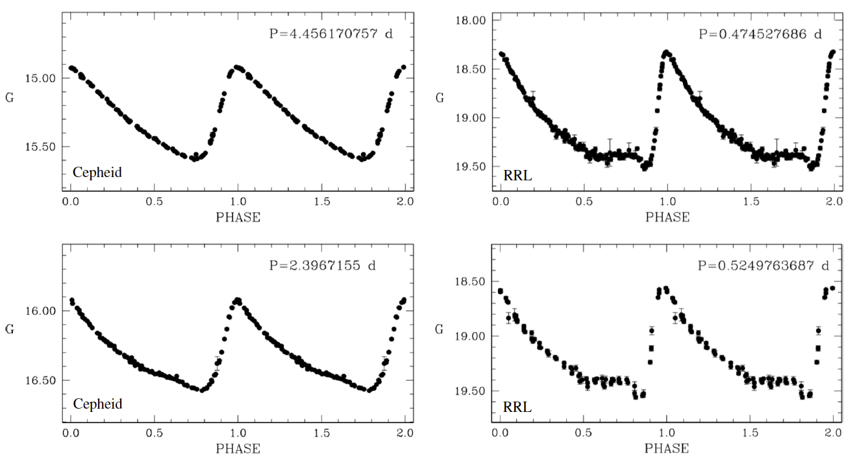
Content of the Gaia Data Release I (Gaia DR1)
Light curves for ~ 3200 stars
  2600 RR Lyr (343 new) , 600 Cepheids (43 new)
  The majority in the LMC (Grand Nuage de Magellan)
  Accuracy of individual measurement ~ 3-10 mmag
credit : ESA/Gaia/DPAC
30

Slide 31
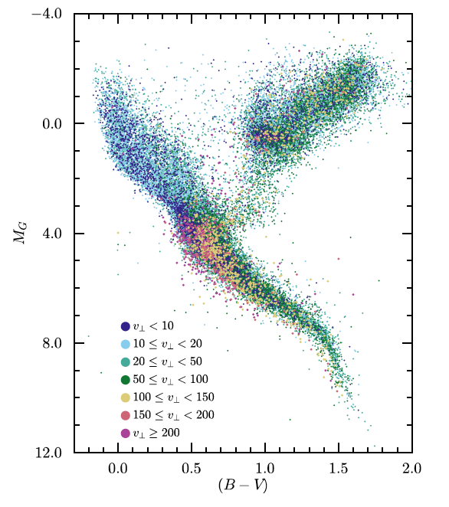
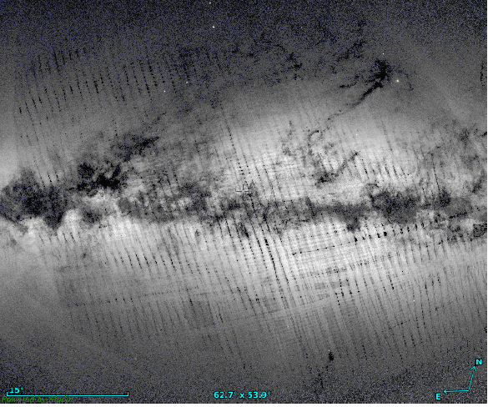
Limitations of the DR1
Only 14 months of data
  Calibrations rather limited
  No colour for the vast majority of stars
  No bright star ( < 7 mag), no high-proper motion star
  Parallax zero-point could be as large as 0.3 mas
  Spatial resolution degraded during identification
  Severe filtering to remove false detections
    removed also genuine stars
  Completeness questionable in dense areas
31

Slide 32
Toward Gaia DR2
Data have been collected since in a routine mode
  Astrometry and photometry based on roughly 22 months of data
  Gaia stand-alone astrometric solution (unlike TGAS, no priors needed)
  5-parameter astrometry for all sources
    parallax to 50 muas at G = 15
  Broad band photometry, G , GBP , GRP (broad band colours)
  Improved photometric calibrations
  Median radial velocities for bright (GRVS < 12), constant RV, stars
  Solar system object results
  Cepheids, RR Lyrae all sky, LPV, short time scale variables
32

Slide 33
Conclusions
Gaia is performing its mission largely as planned
The detected problems are not significantly impairing the data collection
The accuracy is slightly degraded but remains unchallenged
The survey goes fainter than expected
  G = 20.7 instead of G =20
Sources brighter than G= 5.7 are observed
Detections of extended sources (> 1") are successful
Consumable level would allow a 10-year + mission
Instrument is more complex than expected and impacts on the data processing speed

Slide 34
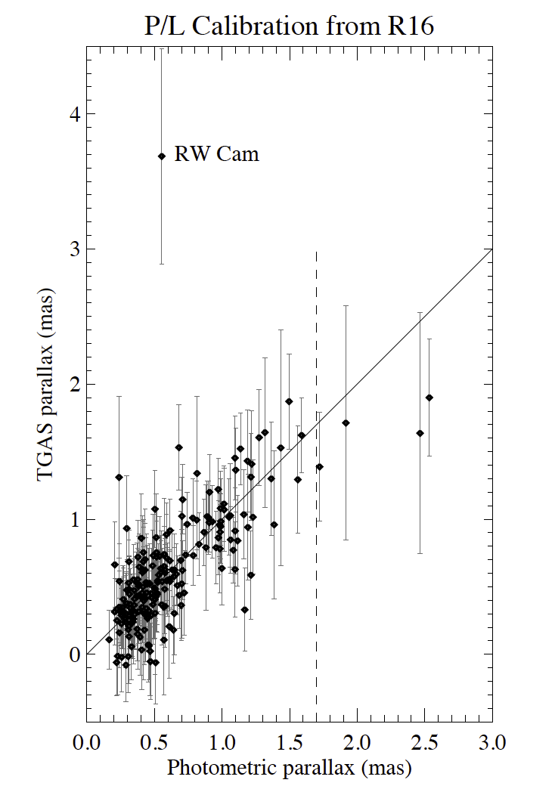
Validation Gaia Data Release I (Gaia DR1)
Several publications since the release
  Primarily related to the distance scale
Cepheid distances
  Casertano, Reiss et al. arXiv:1609.05175
  Comparison of parallaxes of 212 galactic cepheids
  Photometric parallax vs. Gaia
  Very good agreement
  Gaia quoted errors found conservative
    maybe 20% too large
credit : Casertano et al.
34

Slide 35
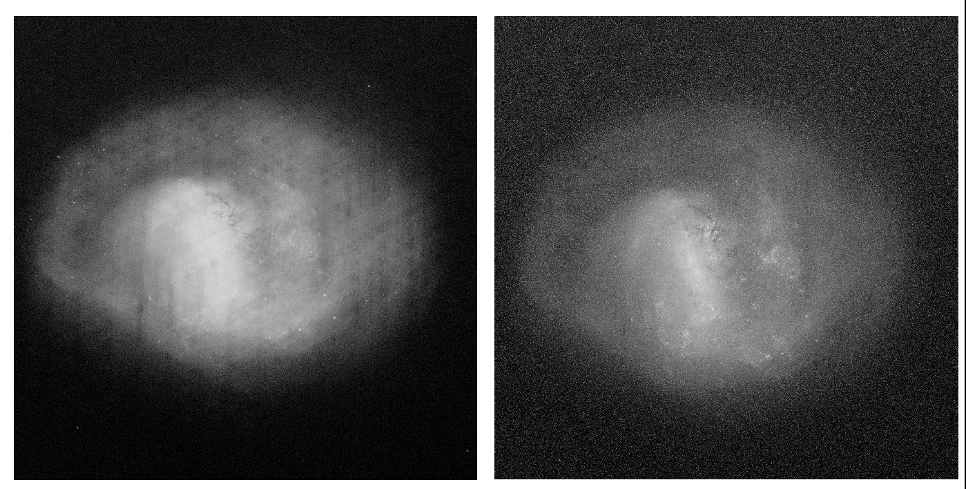
Different visualisation of LMC (A. Moitinho et al.)
Density map
Flux map
35

Slide 36
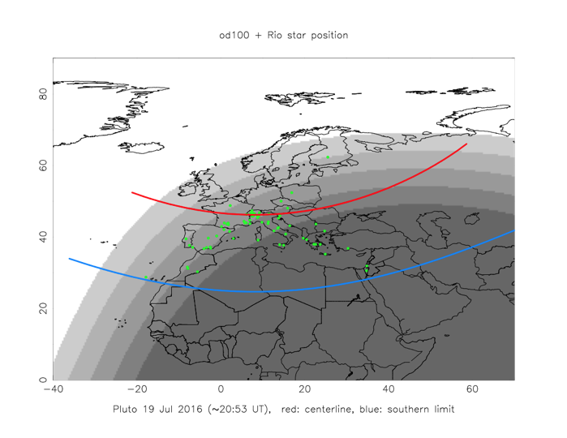
Early predicted occultation with Pluto
Credit : B. Sicardy, P. Tanga et al.

Slide 37
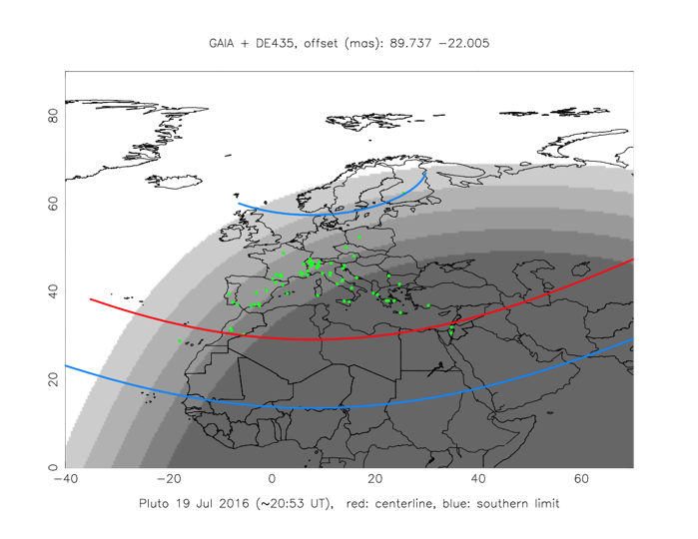
Prediction using the Gaia position for the star and New Horizon for Pluto
Credit : B. Sicardy, P. Tanga et al.

Slide 38

Post-occultation reconstruction
Credit : B. Sicardy, P. Tanga et al.

